Slide 1


Introducing Antiracist critical thinking
Nuzhat Uthmani
Global Citizenship Education in Scotland
March 2023

Slide 2
Antiracist critical thinking
Nuzhat Uthmani (she/her)
Acting Principal Teacher, Glasgow
Lead on Equalities & Sustainability, Antiracism & Global Citizenship
Chair of the EIS Antiracist Sub Committee
Co-Chair Scot Gov Diversity in the Teaching Profession sub group
@NUthmani @GCEducationScot - gceducationscot@gmail.com

Slide 3

Initial Reflections
Go to www.menti.com and
use the code 1812 7828

Slide 4

Role of scotland’s schools
“Get comfortable with our discomfort.”
What should schools of 21st Century Scotland look like?
Priorities:
Recognise Scotland’s place in empire, colonialism and slavery and the impact on our diverse communities.
Create a space for unlearning and new collaborative learning.
Embed antiracism in the curricula & culture.
Increase representation of minority communities in our decision making structures and processes.
Increase engagement with minority communities.
Co-production with minority communities.
Increase the racial literacy and cultural competency of the education workforce.

Slide 5

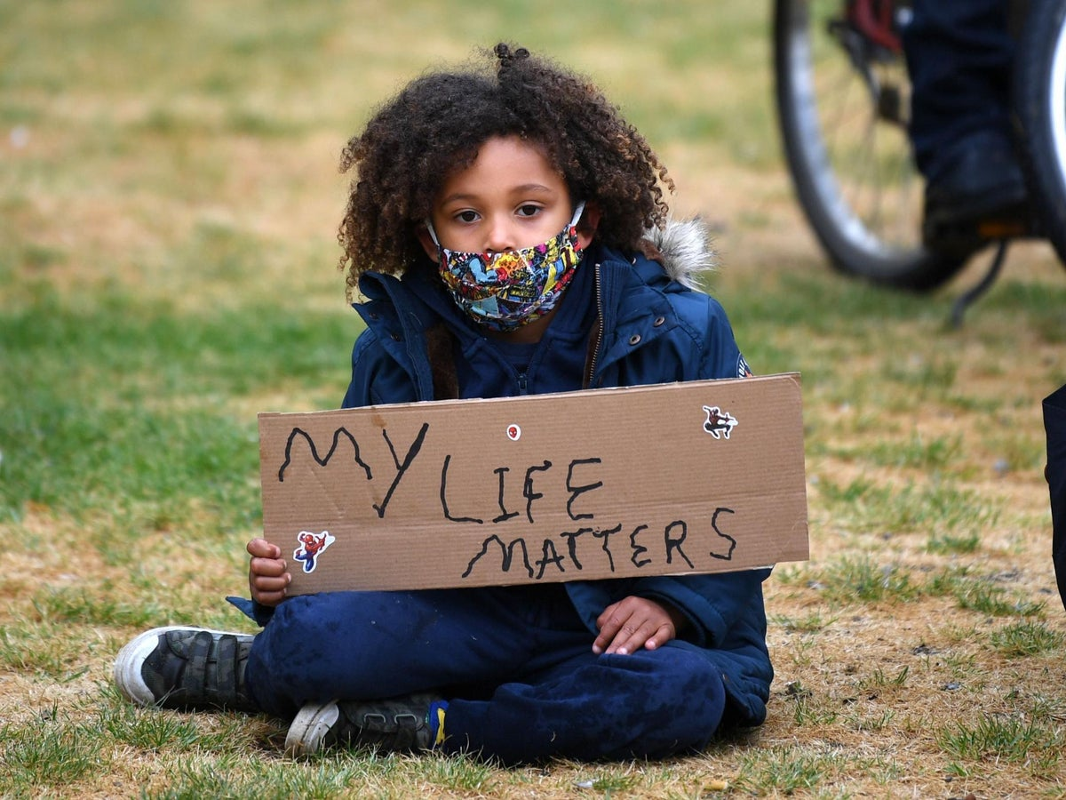
Current developments
Scottish Government’s Antiracism in Education Programme
Diversity in the Education Workforce
Curriculum Reform
Tackling Racism & Racist Incidents in schools
Professional Leadership and Learning

Slide 6

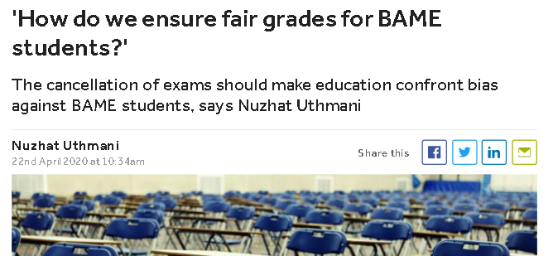
Antiracism – why now?

Slide 7

Diversity v antiracism
“‘Race’ is strongly linked to skin colour. White populations across the world were not ‘racialised’ in the same way non-white populations were.
Their process of racialisation brought advantages rather than disadvantages.”
Coalition for Racial Equity and Rights

Slide 8

Where do we want to be?
*Why do we teach what we teach?
*Whose perspective is it from?
*Whose perspective is missing?
*Sense of identity
*Valuing background and lived experience
*Stand alone events
*Inclusion and parental engagement
*Knowledge of racial literacy
*What resources do we use?

Slide 9
Developing antiracist practice
What if we don’t have lived experience?
What if we don’t have access to community groups or individuals that can support our antiracism work?
How do we judge if a resource or example is racist?
How can we build our knowledge and understanding in this area?

Slide 11
WORLD WAR II: Why have you chosen this resource or example?

Slide 12
Whose perspective is it from?

Slide 13
Whose perspective is missing?

Slide 14
Why is it missing?

Slide 15

Who does it impact on?

Slide 16

How does it link with modern Scotland today?

Slide 17
Role of scotland’s schools
How do we fulfil these priorities?
Recognise Scotland’s place in empire, colonialism and slavery and the impact on our diverse communities.
Be factual, facilitate discussions, encourage critical thinking.
Create a space for unlearning and new collaborative learning.
Staff research groups, share professional development.
Co-design learning with pupils around the issues important to them.
Embed antiracism in the curricula & culture.
Implement the Antiracist Critical Thinking Model
Increase representation & engagement of minority communities in our decision making structures and processes.
Diversify your parent council & those who you consult with.
Not just for schools with a multicultural demographic.
Co-production with minority communities.
Involve families in decision making and planning of events.
Increase the racial literacy and cultural competency of the education workforce.
Building Racial Literacy Programme, Education Scotland
Read, watch and LISTEN

Slide 18
Over to you
Do you find this model helpful to use in your context?
What opportunities will it provide you?
What challenges may remain in using it or adopting it in your context?
Have a go!

Slide 19

Optional extension task
Choose an aspect of your teaching or management within your context to apply the Antiracist Critical Thinking Model.
Use the supplied template to make points under each question
Email your model to me at gceducationscot@gmail.com for feedback and further discussion.
https://blogs.glowscotland.org.uk/gc/globalcitizenshiped/antiracist-critical-thinking/
Go to www.menti.com and use the code 2254 4026

Slide 20
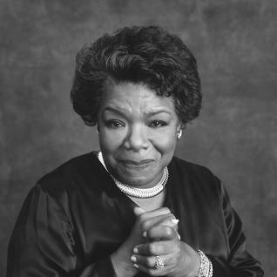
Any Questions or feedback
“Do the best you can until you know better.
Then when you know better, do better."
@NUthmani @GCEducationScot - gceducationscot@gmail.com

